Slide 1


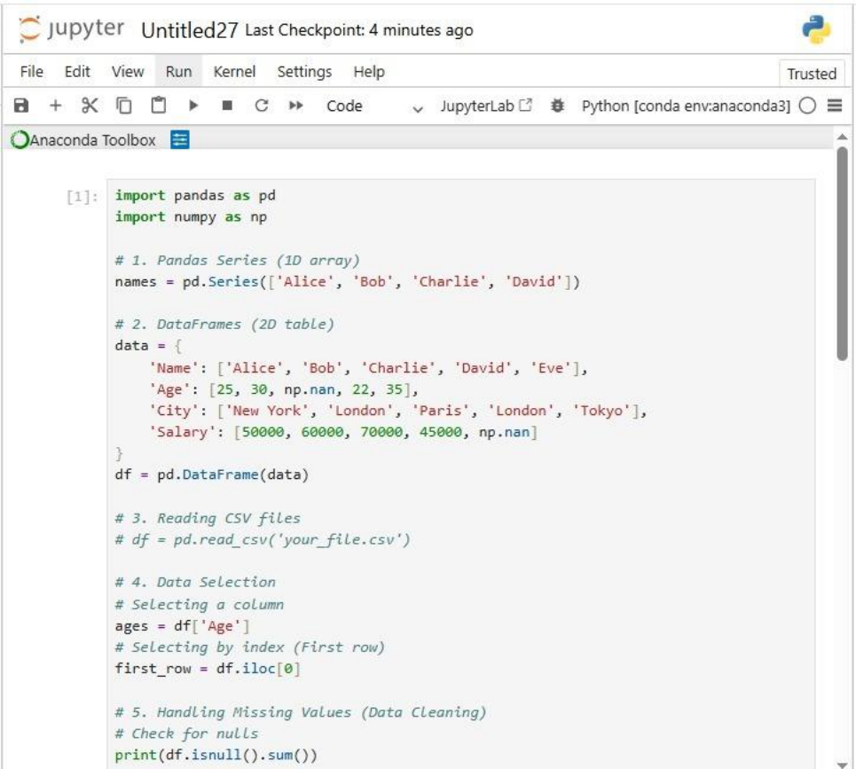
Pandas Data Analysis Guide
1. Fundamental Data Structures
Pandas Series: Think of this as a single column of data. It is a one-dimensional array-
like object that can hold any data type (integers, strings, floating point numbers, etc.)
and has an associated array of data labels called an index.
DataFrames: This is the "bread and butter" of Pandas. It is a two-dimensional, size-
mutable, potentially heterogeneous tabular data structure with labeled axes (rows
and columns). Essentially, it's like an Excel spreadsheet or a SQL table.

Slide 2

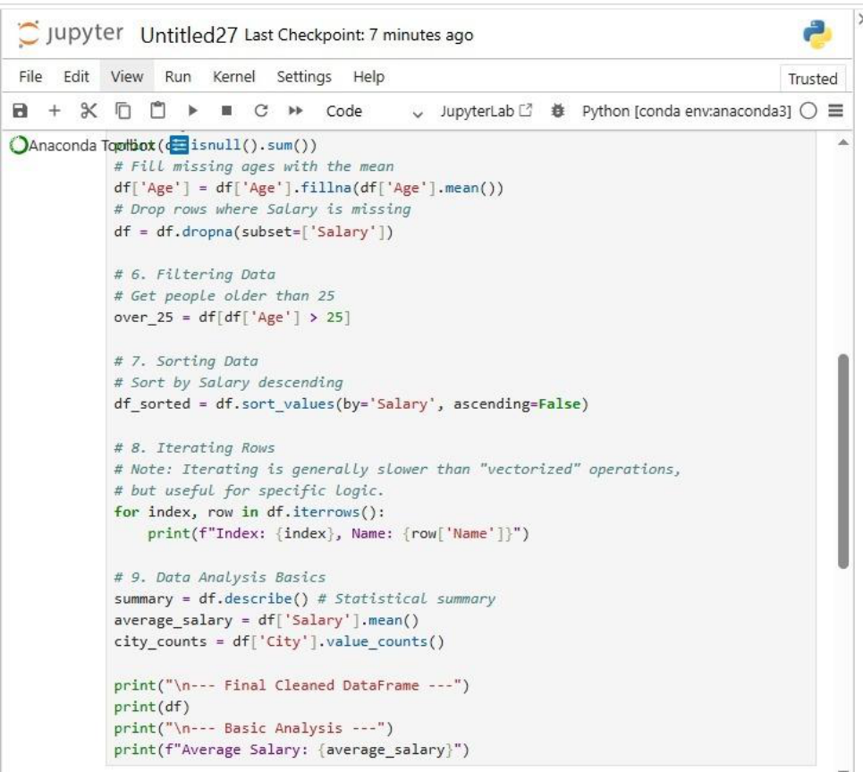
2. Data Acquisition and Cleaning
Reading CSV Files: CSV (Comma Separated Values) is the most common format for
data science. Pandas uses the read_csv() function to load these files directly into a
DataFrame, automatically handling headers and delimiters.
Data Cleaning: Raw data is often messy. This process involves fixing structural errors
(like typos in column names), removing duplicates, and ensuring that data types are
correct (e.g., making sure a "Date" column is actually recognized as a date and not
just a string).
Handling Missing Values: In real-world data, you often find "NaN" (Not a Number)
entries. You must decide whether to:
•
Drop them: Remove the row or column entirely.

Slide 3

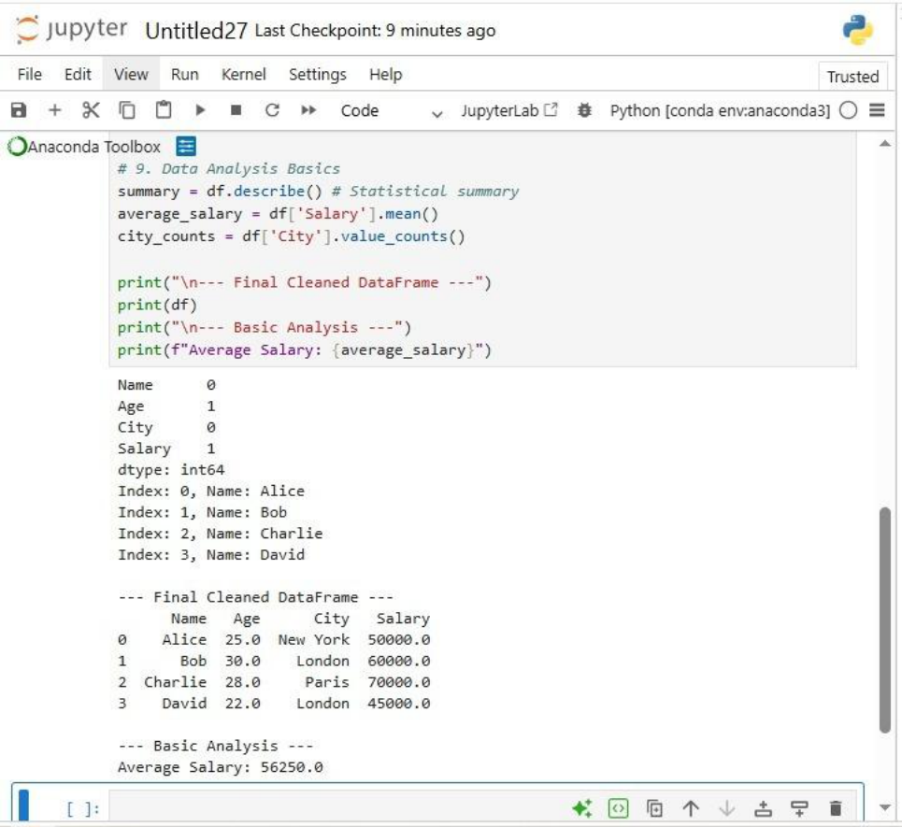
•
Fill them: Replace the gap with a specific value, like the mean or median of that
column.
3. Data Manipulation
Filtering Data: This allows you to zoom in on specific parts of your dataset based on
conditions. For example, "Show me all rows where 'Sales' is greater than 500."
Sorting Data: Organizing your table based on the values in one or more columns.
You can sort alphabetically, numerically, and in ascending or descending order.
Data Selection: This involves "slicing" the data to get exactly what you need.
•
.loc: Used for selecting data by the label of the row/column.

Slide 4
•
.iloc: Used for selecting data by the integer-based position (index).
Iterating Rows: While usually discouraged for large datasets (because it’s slow), this
involves looping through each row of the DataFrame one by one to perform custom
logic or calculations.
4. Data Analysis Basics
Descriptive Statistics: Using simple commands to get a high-level overview of your
data, such as the mean, median, standard deviation, and count.
Aggregation: Grouping data together (e.g., "Group by City") to find the total or
average of values within those specific categories.

